Slide 1

PLASTIC RECYCLING & TRACKING ECOSYSTEM
SDG 12 – RESPONSIBLE CONSUMPTION & PRODUCTION
PRIME SQUAD
LEADER DETAILS: SANJAI PRASATH M, msanjaiprasathsanjaiprasath@gmail.com, 9345696430

Slide 2
MOTIVATION – THE PROBLEM
Despite increased awareness, most plastic waste still ends up unrecycled due to poor traceability, data manipulation, and lack of accountability in the recycling chain.
Why it matters:
91% of plastic waste globally remains unrecycled.
Poor management causes pollution, landfill overflow, and CO2 emissions.
Authorities and recyclers struggle to validate recycling data.
Target Audience: Municipal bodies, recyclers, waste collectors, NGOs.

Slide 3
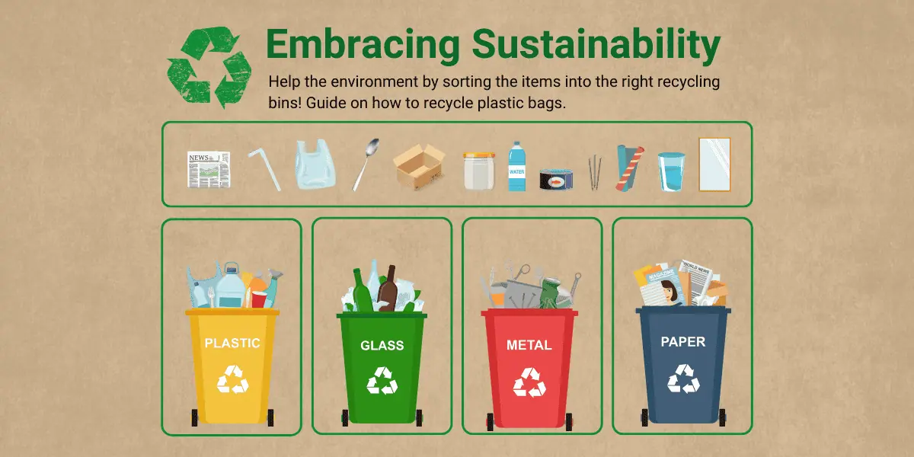
WHY THIS IS A PROBLEM
Wrong data → fake recycling numbers → failure of SDG 12 goals.
Plastic gets dumped on roads/empty lands instead of recycling.
Government cannot take action because there is no traceability.
No real-time monitoring → delays → overflowing bins.

Slide 4
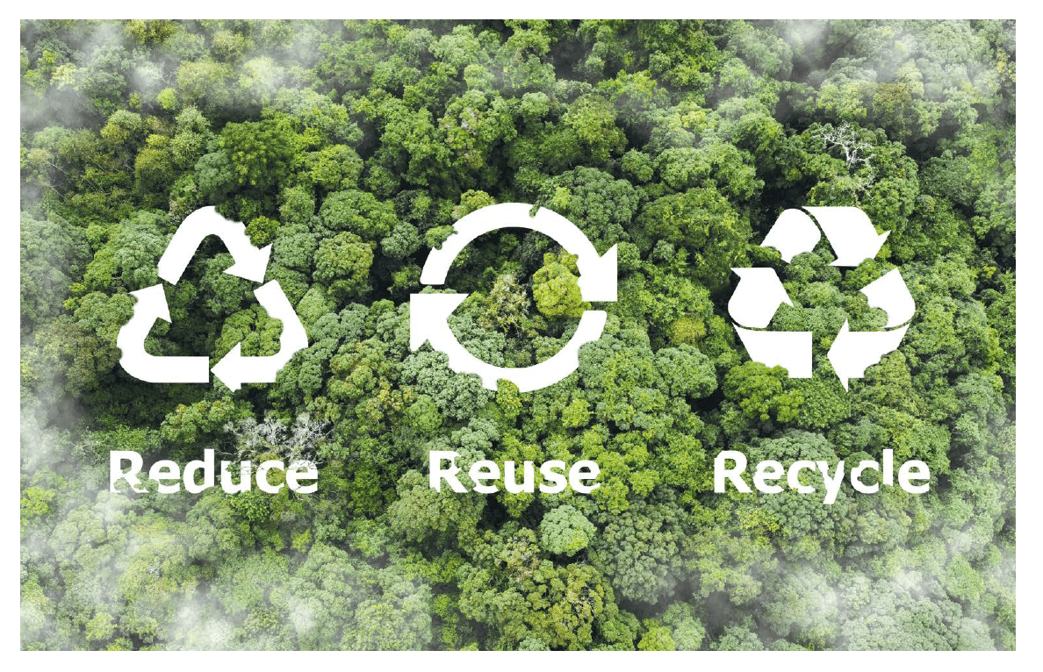
MOTIVATION – REAL-WORLD IMPACT
Plastic pollution is an urgent environmental crisis.
A transparent, tamper-proof system can revolutionize how waste is collected, tracked, and recycled.
This project aims to:
Promote responsible consumption.
Create an ecosystem of accountability.
Support Sustainable Development Goal 12.

Slide 5
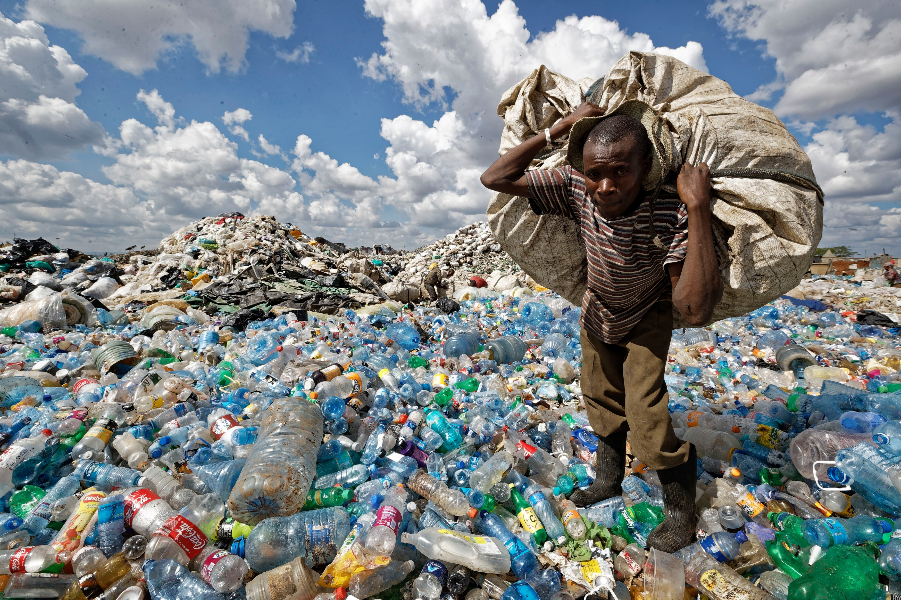
PROPOSED SOLUTION – OUR INNOVATION
A Hybrid Blockchain + IoT system to ensure complete transparency in the plastic recycling lifecycle.
We create a Smart IoT-Based Plastic Tracking System using:
ESP32 to control all sensors
HX711 + Load Cell to measure exact plastic weight
GPS Module to track exact location of plastic collection
GSM Module to upload data without Wi-Fi
Battery to make the system portable
Every time plastic is collected → the system automatically sends: ✔ Weight ✔ Location ✔ Time ✔ Collector ID
…to the cloud dashboard. This makes the recycling process 100% transparent and tamper-proof.

Slide 6
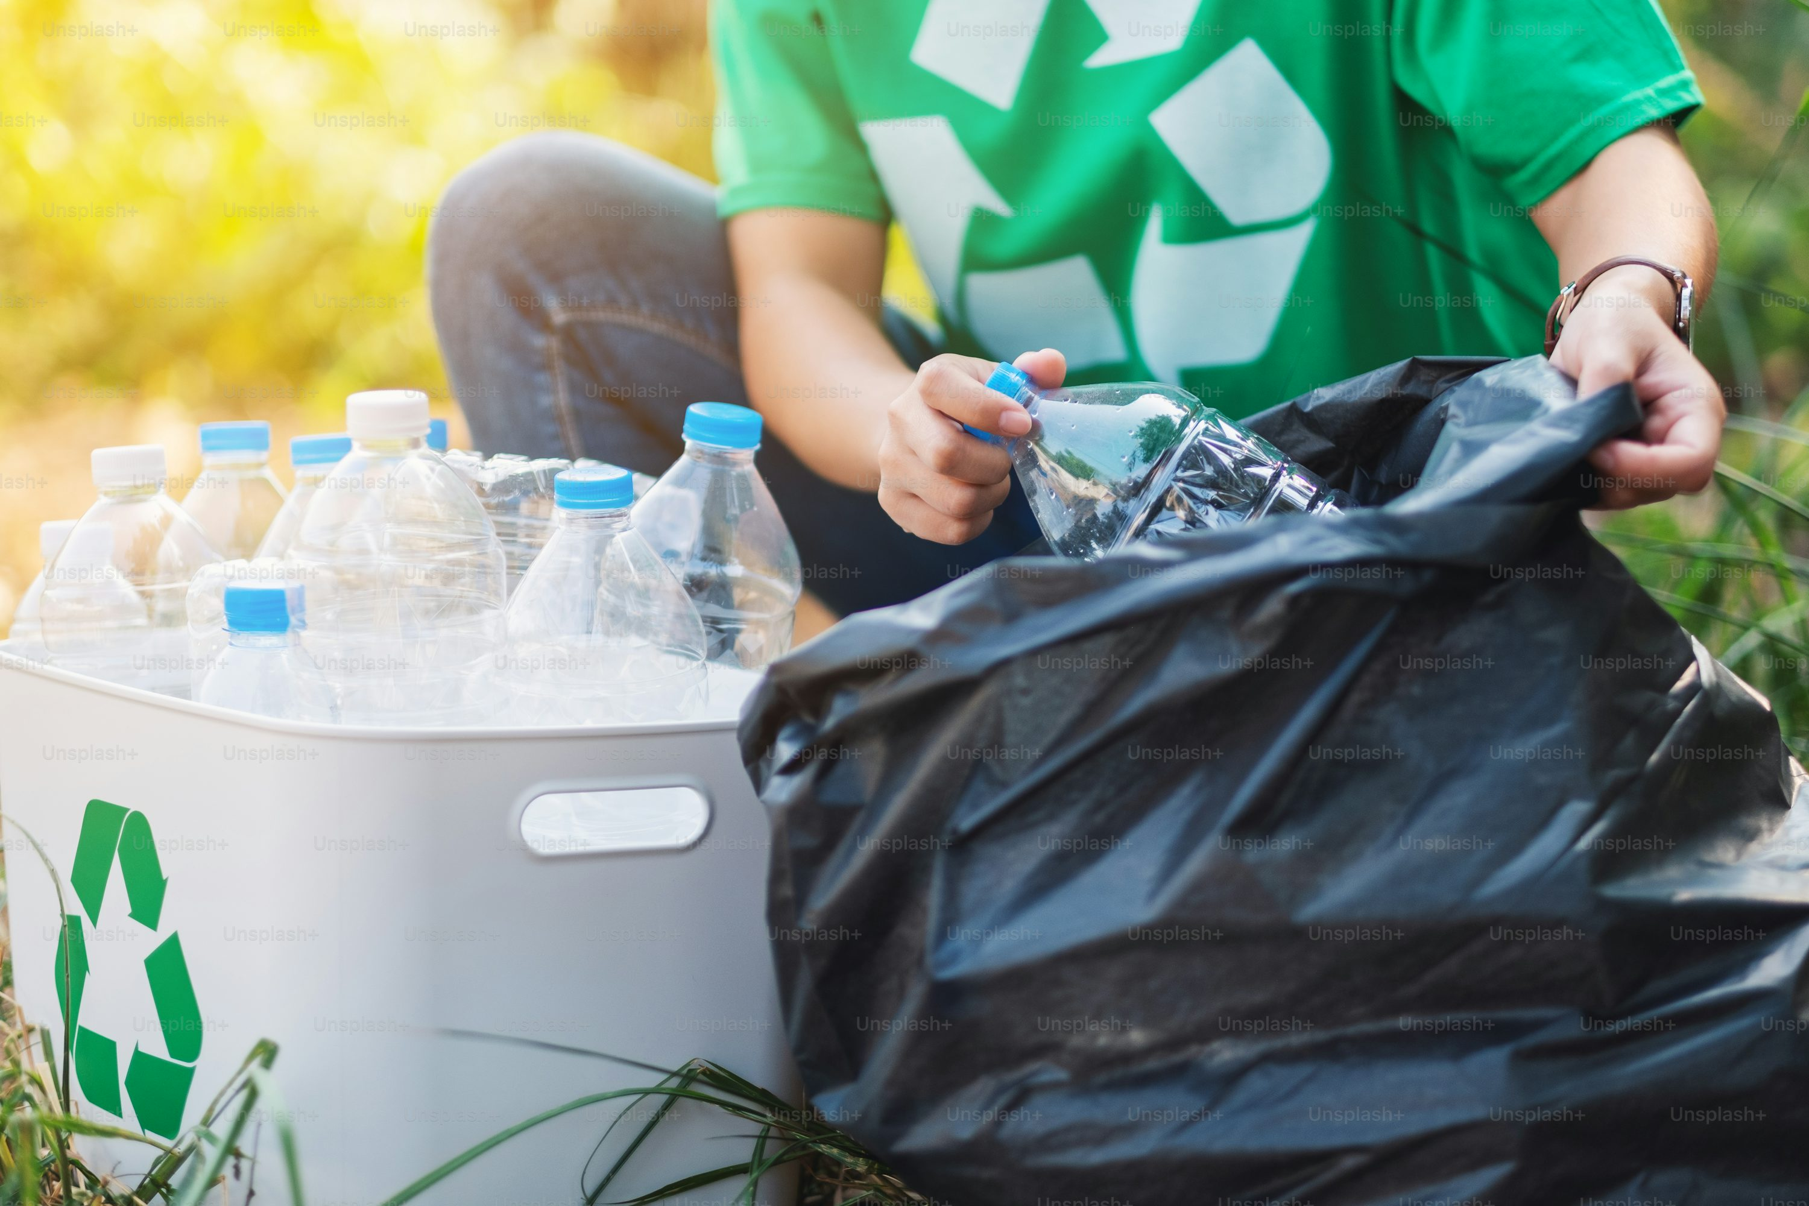
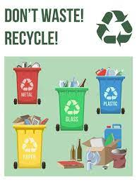
PROPOSED SOLUTION – SYSTEM OPERATION
Plastic is placed on the weighing platform.
HX711 + Load Cell measures the weight accurately.
GPS Module reads the location of collection point.
ESP32 combines weight + location + timestamp.
GSM Module uploads data to cloud instantly.
Dashboard shows live details to government/recycling centre.

Slide 7
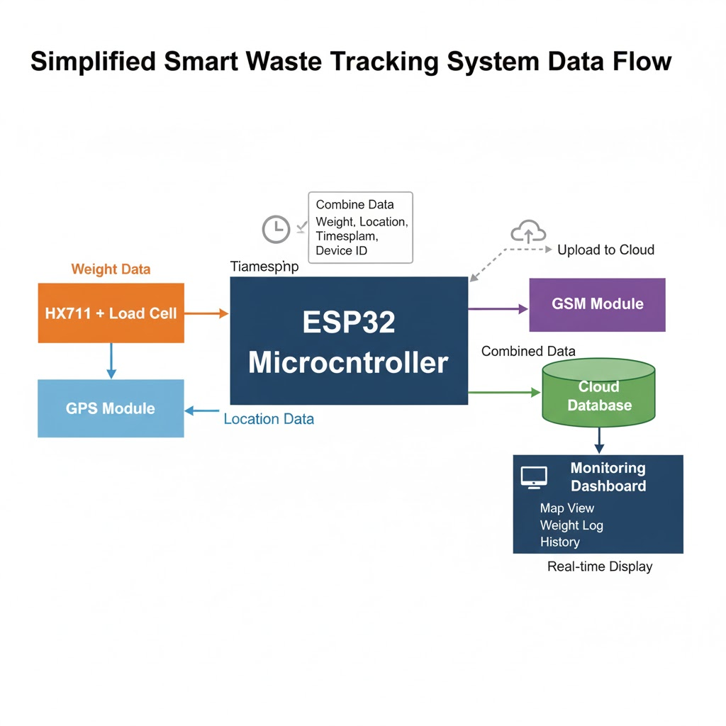
ARCHITECTURE
WHY OUR COMPONENTS ARE PERFECT
1. SENSOR LAYER
HX711 + Load Cell → Measures plastic weight
GPS Module → Reads location coordinates (Latitude, Longitude)
This layer collects real-world data.
2. PROCESSING LAYER
ESP32 Microcontroller
Reads the weight from HX711
Reads GPS location
Combines weight + location + timestamp
Packs data into a formatted message
.

Slide 8
ARCHITECTURE
3. COMMUNICATION LAYER
GSM Module (SIM800L / SIM900A)
Sends data to the cloud through mobile network
Uploads weight + location + collector ID in real time
This layer ensures wide-range connectivity without Wi-Fi.
4. CLOUD & APPLICATION LAYER
Cloud Database (Firebase / Thingspeak / Custom server)
Dashboard or Mobile App
Displays:
Live weight
GPS location on map
Time of collection
Collector ID
History log
This layer offers monitoring, analytics, and decision-making.

Slide 9
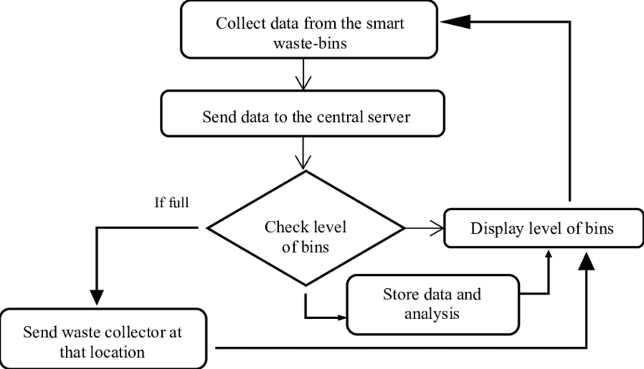
FLOWCHART
Step 1: Measure Weight
HX711 + Load Cell senses the plastic weight.
Step 2: Read GPS Location
GPS module gets Latitude + Longitude.
Step 3: Process Data in ESP32
ESP32 combines weight + location + timestamp.
Step 4: Send Data to Cloud via GSM
GSM uploads the data to the cloud database.
Step 5: Display on Dashboard
Cloud dashboard shows live tracking details.

Slide 10
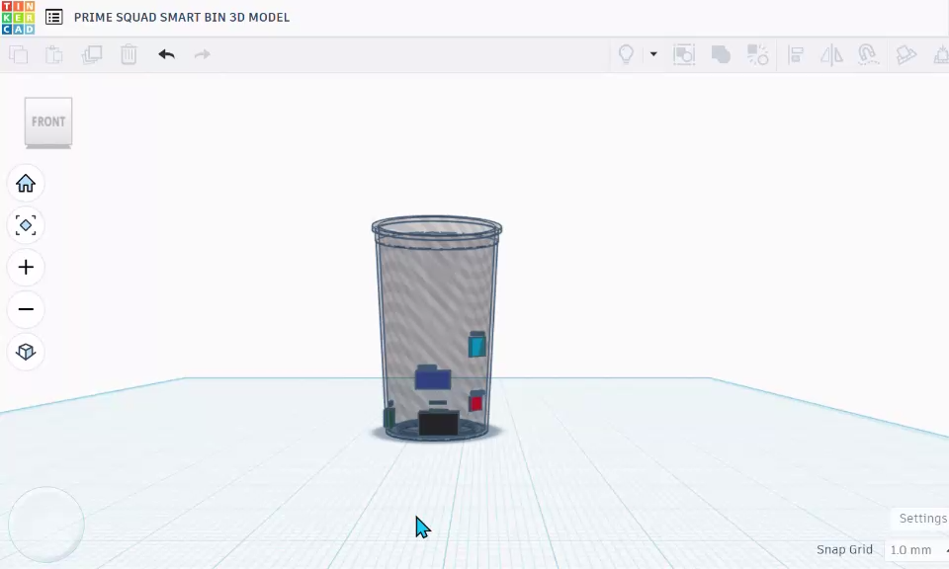
PROPOSED 3D MODEL
✔ The bin contains a load cell at the bottom to measure plastic weight.
✔ All electronic components (ESP32, HX711, GPS, GSM) are placed inside a protected compartment.
✔ When plastic is dropped, the load cell senses the weight instantly.
✔ ESP32 processes the data and the GSM module sends it to the cloud.
✔ The 3D model shows how all parts are compactly arranged inside the smart bin.

Slide 11
ADVANTAGES OF OUR SYSTEM
✔ Real-time tracking ✔ No manual entry → No cheating ✔ Weight accuracy ✔ Portable design ✔ Works without Wi-Fi ✔ Supports SDG 12 with responsible data
APPLICATIONS
Municipal waste collection
Smart recycling centres
NGO waste pickup programs
Smart city waste management
College/school recycling drives

Slide 12
IMPACT & FUTURE SCOPE
Expected Impact:
✔ Builds transparency in plastic collection
✔ Prevents weight manipulation by collectors
✔ Helps government track real-time recycling progress
✔ Reduces plastic dumping and environmental pollution
✔ Supports SDG 12 with responsible waste management
Future Scope:
Add Blockchain for Proof-of-Recycle Tokens
Add QR/NFC tags on collected bags
Add machine learning to classify item types
Integrate with carbon credit tracking
Use solar power for long battery life
Build full mobile app for worker verification

Slide 13
THANK YOU!
Presented by:
Sanjai prasath M- BME – III -9345696430
Nisha M- BME – III -9629930704
Harini K - AIML – I - 6382 087 395
Athish M – ECE A – I -9342758597
Ajithkumar S – ECE A – I - 9385477963

